Slide 1
LC-3 Assembly Language

Slide 2
Download the lc3 simulator
In the section of AsULearn titled "Simulators and Tools" is a file named LC3Simulator.jar.
Download this file now and make sure you can open it.
If you can run BlueJ you should be able to run the simulator.
If you have bought a new computer or reinstalled your OS you will have to reinstall Java.
There is a file in the "Simulators and Tools" section named Jarfix that can help windows users get Java set up correctly.
DON'T use Jarfix unless you have Java installed but are having trouble getting it to run.
Getting a Java program to run on a Mac is particularly troublesome. There is a set of slides specifically for Mac users.
Not being able to get the simulator to run is not an excuse for missing assignments.
Having a proper computer is your responsibility. Go to tech support or see me in my office if you need help.

Slide 3
Programming
Machine Language (object code) – The series of binary numbers that the computer can understand directly. May or may not be ready to run for various reasons.
Assembly Language - A human readable (sort of) way to write code that the computer can easily turn into machine language.
High Level Language – A MORE human readable (sort of) way to write assembly language.
GCC converts C and C++ to assembly then to object code.
Java does something a little different (bytecode and JRE)
Executable Image – The machine language program AFTER it has been finished and is ready to run on the processor.

Slide 4
Instructions
An instruction has two parts:
opcode : The operation being performed.
These are divided into three categories: Operate, Data Movement, and Control
LC3 has 15 opcodes (ADD, AND, BR, JMP, JSR, JSRR, LD, LDI, LDR, LEA, NOT, RET, RTI, ST, STI, STR, TRAP)
operands : The data to use in the operation.
This data is read from somewhere as specified by the instruction and the addressing mode
LC3 has 5 addressing modes (Immediate, Register, PC-Relative, Indirect, Base+Offset)

Slide 5
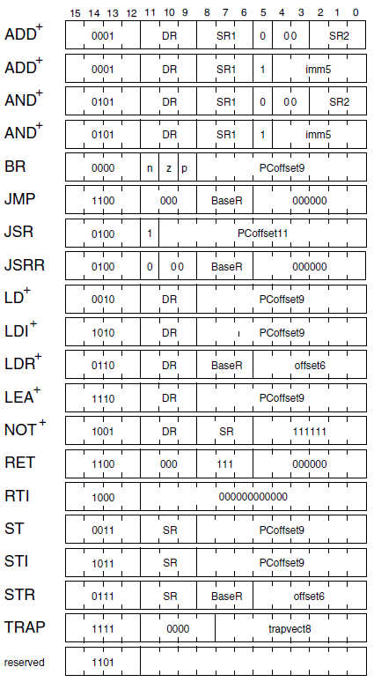
Appendix A

Slide 6
Opcode Summary
Add - ADD value in a register to a value in a register. Store result in a register.
Add - ADD value in a register to a number. Store result in a register.
And - Bitwise AND value in a register to a value in a register. Store result in a register. (The term BITWISE is explained when we discuss AND.)
And - Bitwise AND value in a register to a number. Store result in a register.
Not – Invert all of the bits in a register and store the result in a register.
BR, BRNZP – Conditional branch. Like if statement.
LD, LDR, LDI – Load register with a value from memory
ST, STR, STI – Store register value somewhere in memory.
LEA – Load an address into a register and not the data.
JMP – Jump execution to some other place in memory.
JSR, JSRR – Jump to a subroutine similar to a function or method.
RET – Return from the subroutine
RTI – Return from interrupt, restores process information.
TRAP – System call. Like an operating system. Handles input and output.

Slide 7
Simple Example Program
Labels | Opcode | Operands | Comment | Hex Value
 | .orig | X3000 | ;Specify starting memory | 3000
 | GETC |  | ;R0 <- Keyboard character | F020
 | LD | R3, 9 | ;R3 <- -48 | 2609
 | ADD | R1, R0, R3 | ;R1 <- R0 + R3 | 1203
 | GETC |  | ;R0 <- Keyboard character | F020
 | ADD | R2, R0, R3 | ;R2 <- R0 + R3 | 1403
 | ADD | R0, R1, R2 | ; R0 <- R1 + R2 | 1042
 | NOT | R3, R3 | ; R3 <- ~R3 | 96FF
 | ADD | R3, R3, #1 | ;R3 <- R3 + 1 | 16E1
 | ADD | R0, R0, R3 | ;R0 <- R0 + R3 | 1003
 | OUT |  | ;Display <- R0 | F021
 | HALT |  | ;End of program | F025
 | .fill -48 |  |  | FFD0
 | .end |  | ;End of file

Slide 8
Running a program
Program is loaded into memory at x3000
Program Counter (PC) is set to x3000
The instruction pointed to by the PC is loaded into the Instruction Register (IR).
The PC is incremented at the same time as the loading of the IR.
The instruction is processed and executed.
Repeat until halt is reached.
Note that some instructions change the PC which causes branching.

Slide 9
Data Types and Condition Codes
An ISA can have different data types.
LC3 uses 2's complement numbers (Review of 2s complement below.)
Condition codes are special flags that get set when certain operations occur.
LC3 uses N, P, and Z
N – is set if the result of an operation is negative.
P – is set if the result of an operation is positive (redundant?).
Z – is set if the result of an operation is zero.
Other common flags (that are not in the LC3)
C – the result of the carry out of an add operation
v – set in the even of an overflow condition

Slide 10
Registers
Eight general purpose registers (R0 – R7).
Instruction Register (IR)– Holds the instruction in the microprocessor so it can be interpreted.
Program Counter (PC) – Holds the address of the next program step. Looping is accomplished by changing the value of the PC.
Memory Address Register (MAR) – When transferring to/from memory, this will hold the address of the memory unit to be written or read.
Memory Data Register (MDR) – When transferring to memory, this holds the value to save. When transferring from memory, this holds the value read.
Keyboard Data Register (KBDR) – Holds the ASCII character of the key after it has been typed.
Keyboard Status Register (KBSR) – Status information that lets the microprocessor know a key has been typed and is ready to be read.
Display Data Register (DDR) – Holds the ASCII character to display on the screen.
Display Status Register (DSR) – Status information. Use this to tell the display you are ready to write the character from the DDR to the screen.
Process State Register (PSR) – Information about the current state of the current program.

Slide 11
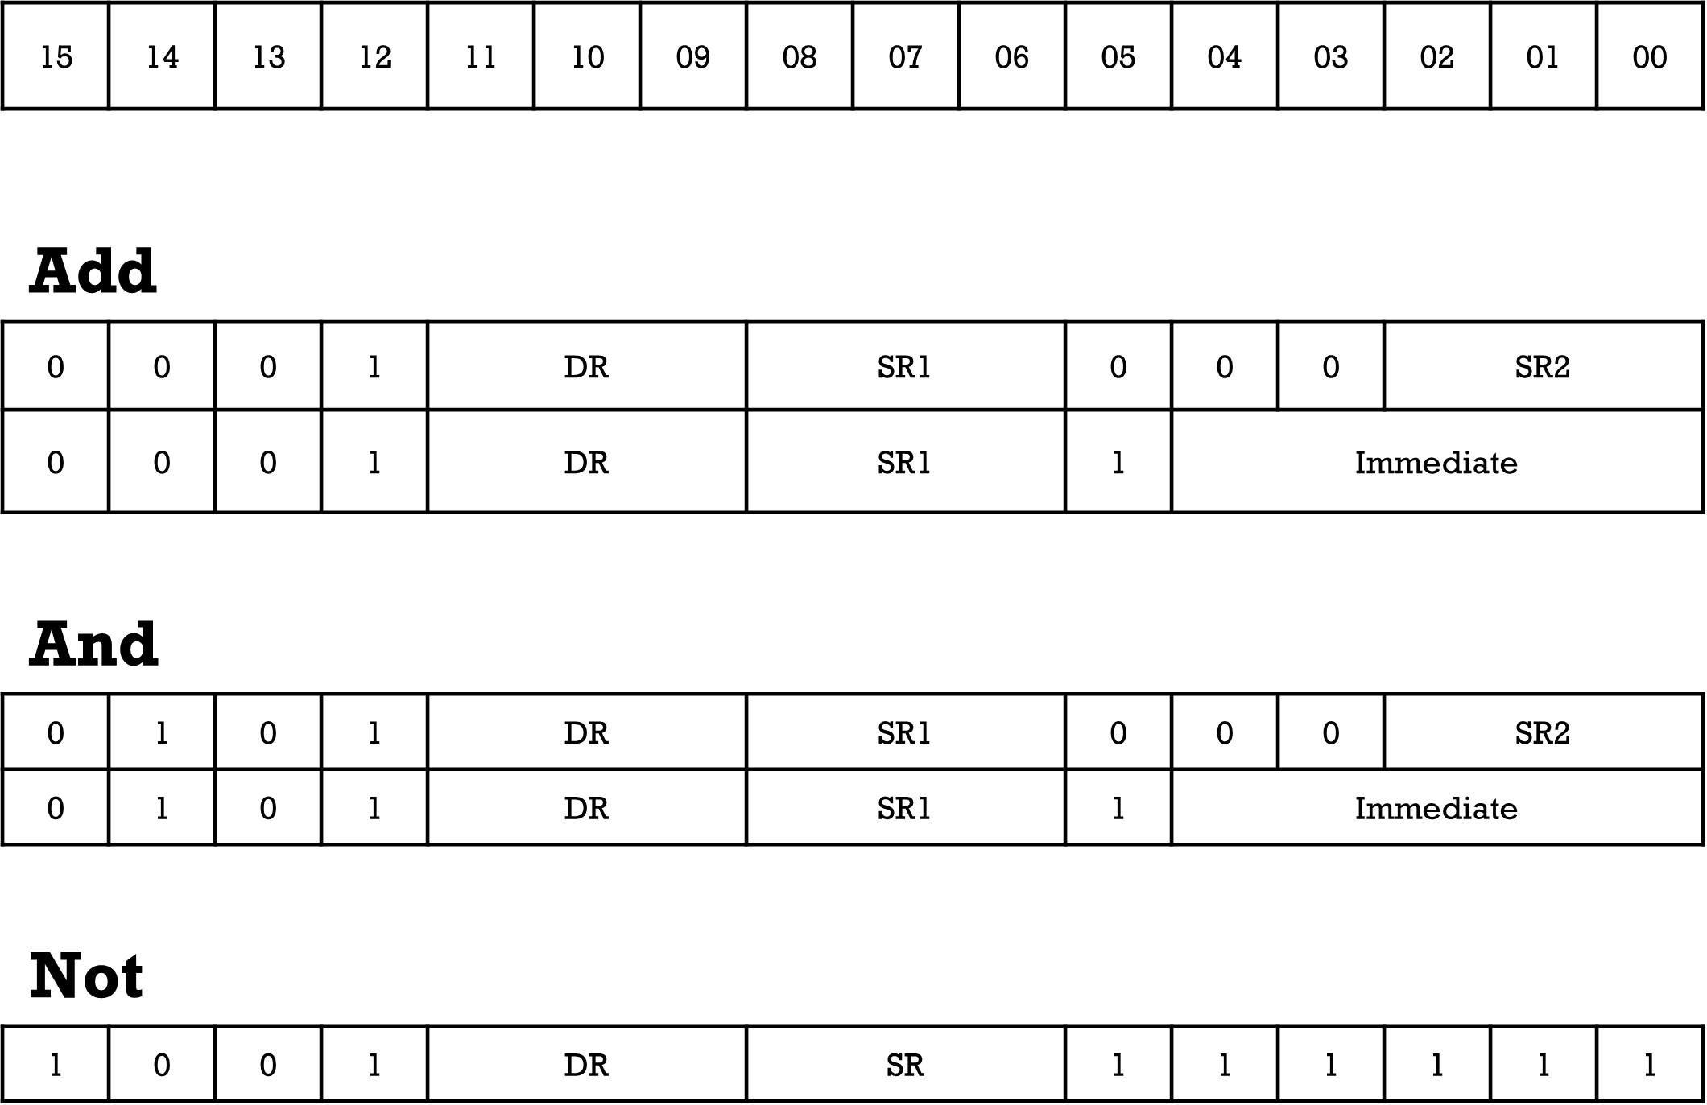
Operate Instructions
On LC3 all operate instructions use register or immediate addressing mode.
Notes:
Describe ADD here

Slide 12
Bitwise
AND & NOT are bitwise operations
Bitwise means it applies the operations you expect but applies the operation on each bit of a binary number.
Bitwise operators ARE NOT logical. They DO NOT use Boolean argument.
Bitwise AND uses single ampersand (& in Java)
Bitwise NOT uses the tilde (~ in Java)

Slide 13
AND Example 1
Assume 4-bit unsigned numbers.
Each pair of bits from the two different values have the AND operator applied.
For bitwise operations, 1 is true and 0 is false.
And means they both have to be true for the output to be true
1001 0011
&1100 &0101

Slide 14
AND Example 2
Assume four-bit unsigned numbers
Each pair of bits from the two different values have the AND operator applied.
For bitwise operations 1 is true and 0 is false.
And means they both have to be true for the result to be true
1001 (9) 0101 (5)
&1100 (12) &0011 (3)
1000 (8) 0001 (1)
Try it in java:
System.out.println(9 & 12);
System.out.println(5 & 3);

Slide 15
sign extension
Immediate values in the LC3 are 5-bit.
But the processor requires 16-bit values.
ADD R0, R0, 5 becomes 0001 0000 0010 0101 with the last 5 bits being the number 5.
5-bit 5 is converted to 16-bit 5 by adding 0s to the left.
0000 0000 0000 0101
But there is a problem for negative numbers.
ADD R0, R0, -5 become 0001 0000 0011 1011
But the same technique doesn't work for negative numbers
0000 0000 0001 1011 IS NOT -5. It is 27. If you add that binary value to a register, you will add 27.

Slide 16
How to Sign extend
When converting from a small storage unit to a larger storage unit using signed number, fill in the extended bits using the sign bit of the original number.
5-bit +5 is
00101
The 16-bit version becomes
0000 0000 0000 0101
5-bit -5 is
11011
The 16-bit version becomes
1111 1111 1111 1011 (which is still -5, do the math)

Slide 17
NOT Example
NOT is a complement. ALL bits are inverted.
Assuming 4-bit unsigned numbers.
~1001 (~9) becomes 0110 (6)
What about Java? What would the following print?
System.out.println(~9);

Slide 18
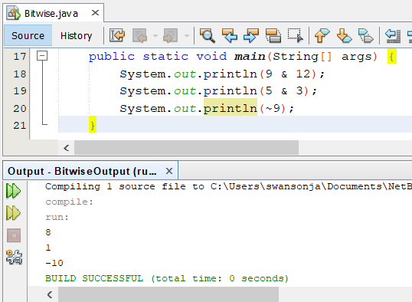
Example of Bitwise and(&) and bitwise not(~)

Slide 19
Operate Instructions
With only ADD, AND, NOT…
R1 = 5, R2 = 3, R3 = 0
Perform the following (write the code in hex)
R1 <- R2 – R1 (Subtraction)
R1 <- R2 | R1 (Bitwise or)
R1 <- R2 (Transfer)
R1 <- 0 (Clear)

Slide 20
Operate Instructions solution
With only ADD, AND, NOT…
Perform the following (write the code in hex)
R1 <- R2 – R1 (Subtraction)
NOT R1, R1 1001 001 001 11111
ADD R1, R1, #1 Convert R1 to -R1
ADD R1, R2, R1
R1 <- R2 | R1 (Bitwise or) R2|R1 = ~~(R2|R1) = ~(~R2 & ~R1)
NOT R2, R2 R2 <- ~R2
NOT R1, R1 R1 <- ~R1
AND R1, R1, R2 R1 <-~R2 & ~R1
NOT R1, R1 R1 <- ~R1
R1 <- R2 (Transfer)
ADD R1, R2, #0
R1 <- 0 (Clear)
AND R1, R1, #0

Slide 21
Operate Instructions in hex
R1 <- R2 – R1 (Subtraction)
NOT R1, R1 1001 001 001 111111 1001 0010 0111 1111 x927F
ADD R1, R1, #1 0001 001 001 1 00001 0001 0010 0110 0001 x1261
ADD R1, R2, R1 0001 001 010 0 00 001 0001 0010 1000 0001 x1281
R1 <- R2 | R1 (Bitwise or) R2|R1 = ~~(R2|R1) = ~(~R2 & ~R1)
NOT R2, R2 1001 010 010 111111 1001 0100 1011 1111 x94BF
NOT R1, R1 1001 001 001 111111 1001 0010 0111 1111 x927F
AND R1, R1, R2 0101 001 001 0 00 010 0101 0010 0100 0010 x5242
NOT R1, R1 1001 001 001 111111 1001 0010 0111 1111 x927F
R1 <- R2 (Transfer)
ADD R1, R2, #0 0001 001 010 0 00 000 0001 0010 1000 0000 x1280
R1 <- 0 (Clear)
AND R1, R1, #0 0101 001 001 1 00001 0101 0010 0110 0001 x5261

Slide 22
Data Movement Instructions
Moving data from
Register to memory
Memory to register
(Register to register is covered under operate instructions)
Addressing modes
PC-Relative
Indirect
Base + offset

Slide 23
PC Relative 1
Uses the current value of the program counter
Adds a value specified in the instruction.
LD – Load value from memory and place it into a register.
ST – Stores register value in memory.
4-bit opcode, 3-bit register, 9-bit value
Value is 9-bit 2's compliment (Range?)
Effective address – The ACTUAL address of the operand. This is the value after all calculations and redirections have been made.

Slide 24
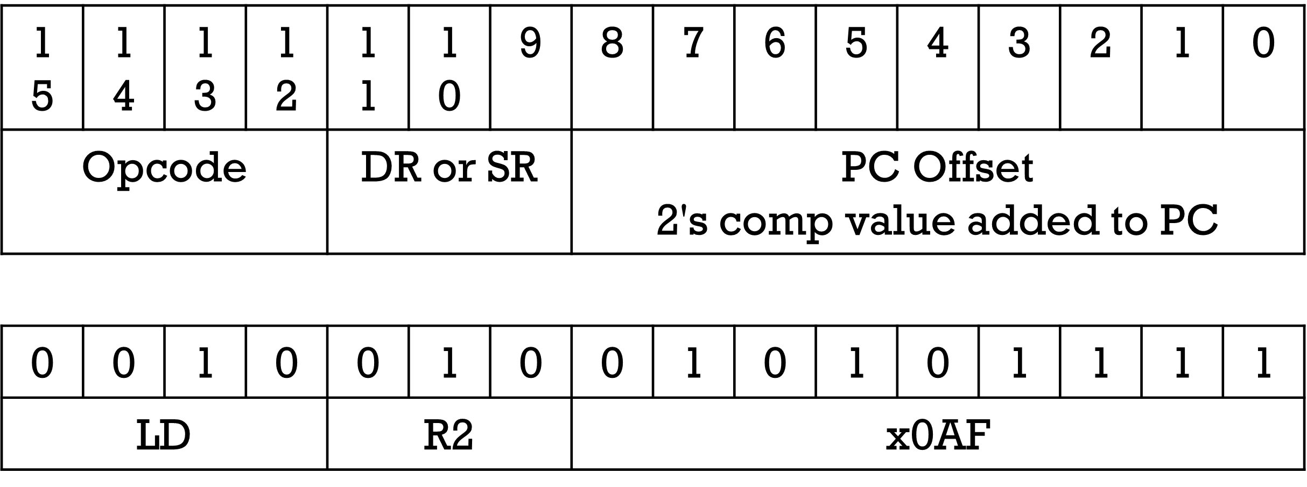
PC Relative 2
LD – Load value from memory and place it into a register.
ST – Save value from register to memory
Load what is stored in memory location PC + x0AF into R2
Assume this LD is stored at x3000, what is the effective address?

Slide 25
PC Relative
LD – Load value from memory and place it into a register.
Assume this LD is stored at x3000, what is the effective address? x30B0
Remember the PC is incremented after loading the instruction.
Assume x0035 is stored at memory location x30B0

Slide 26
PC Relative – calculate the PC offset
ST – Store register value to memory location.
Where in memory do you want to store the data?
What is the PC when this instruction is executed. Note that the PC will ALWAYS be this instruction's address in memory + 1?
The PC Offset (the thing stored in the instruction) is the difference.

Slide 27
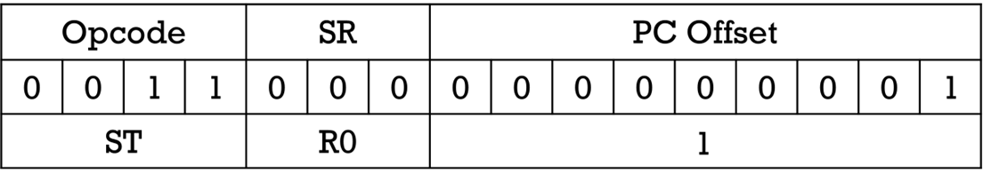
PC Relative – calculate the PC offset Example
Address | Value
3000 | AND R0, R0, #0
3001 | ADD R0, R0, #5
3002 | ST R0, ______
3003 | HALT
3004
3005
3006
3007
3008
3009
300A
300B
We want the program to the right to store R0 into memory location 3004
The ST is at address 3002 therefore the PC will be 3003.
The PC Offset is
Effective Address – PC.
PC Offset = 3004 – 3003 = 1
Store the number 8 as a 9-bit 2s complement number in the PC Offset field.

Slide 28
Example: Add 3 Numbers
This is a new version. Use this version in Fall 2024.
Add three numbers.
Start program at x3000
Values 5,7,and 17 are stored just after the halt.
The sum will be stored just after the above three values.
Only use PC-Relative addressing
LD (0010)
ST (0011)
Will also need add (0001) (Which add? Register or Immediate?)

Slide 29
Webcat warning
Web-CAT can be frustrating and cryptic at times.
You are given a deadline for submitting your programs to Web-CAT.
It is your responsibility to get your program fully completed and uploaded to Web-CAT before that deadline.
If you do not understand some of the instructions in the assignment document or understand the errors you are getting on Web-CAT, you must ask questions.
If you do not give yourself enough time to ask questions and get those questions answered before the due date, then you have not completed the assignment and will receive a bad grade or possibly a zero.
I will not manually grade your programs. The grade you receive from Web-CAT will be your grade in all but the most extreme cases.

Slide 30
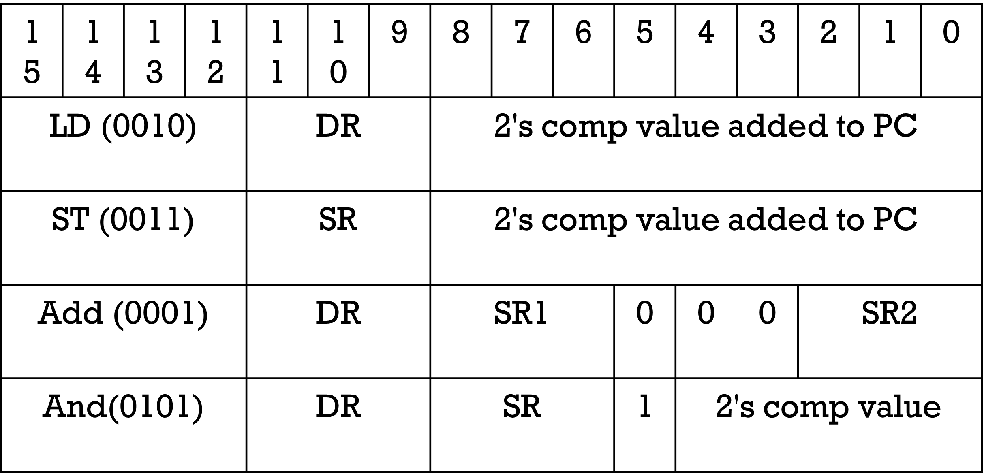
Formats
How can we add three numbers stored in memory?
How many registers will we need? Minimize this as much as possible.

Slide 31
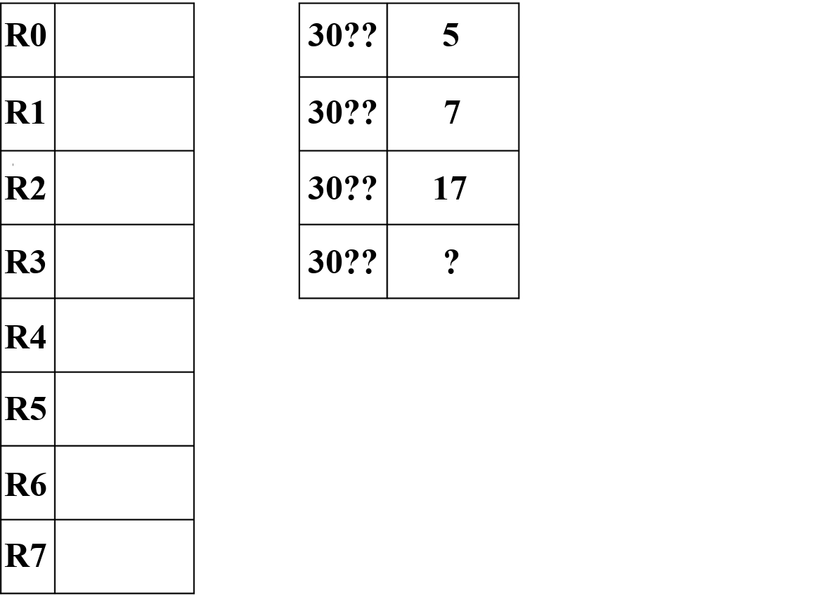
Example program part 1
How could we get the sum of these three numbers stored
in the correct memory location?
What is the correct memory location?
You can only do one of the following:
-Move memory to register
-Move register to memory
-Add two registers and store in a register

Slide 32
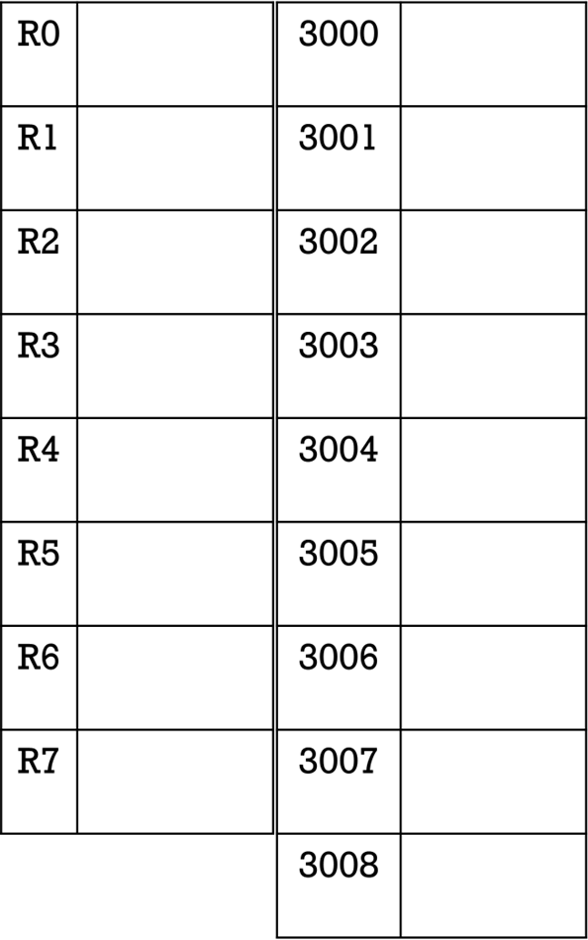
Example program part 2
3000: Clear R0
3001: Load R1 with first number.
3002: Add R0 to R1 and store in R0
3003: Load R1 with second number.
3004: Add R0 to R1 and store in R0
3005: Load R1 with third number.
3006: Add R0 to R1 and store in R0
3007: Store R0 to memory.
3008: HALT
3009: First data number (5)
300A: Second data number (7)
300B: Third data number (17)
300D: Sum of the values of the above three memory locations.

Slide 33
Indirect Addressing
LDI – Load Indirect – Memory to Register
STI – Store Indirect – Register to Memory
LDI and STI are very similar to LD and ST.
Memory calculation for operand is that same, however, the address calculated is NOT actually the operand.
The address calculated is the address of the operand. (TRICKY)
Indirect has one extra step and needs an extra memory access to get the operand.
You need to learn how LDI and STI work.
YOU SHOULD NOT USE LDI OR STI IN YOUR PROGRAMS.

Slide 34
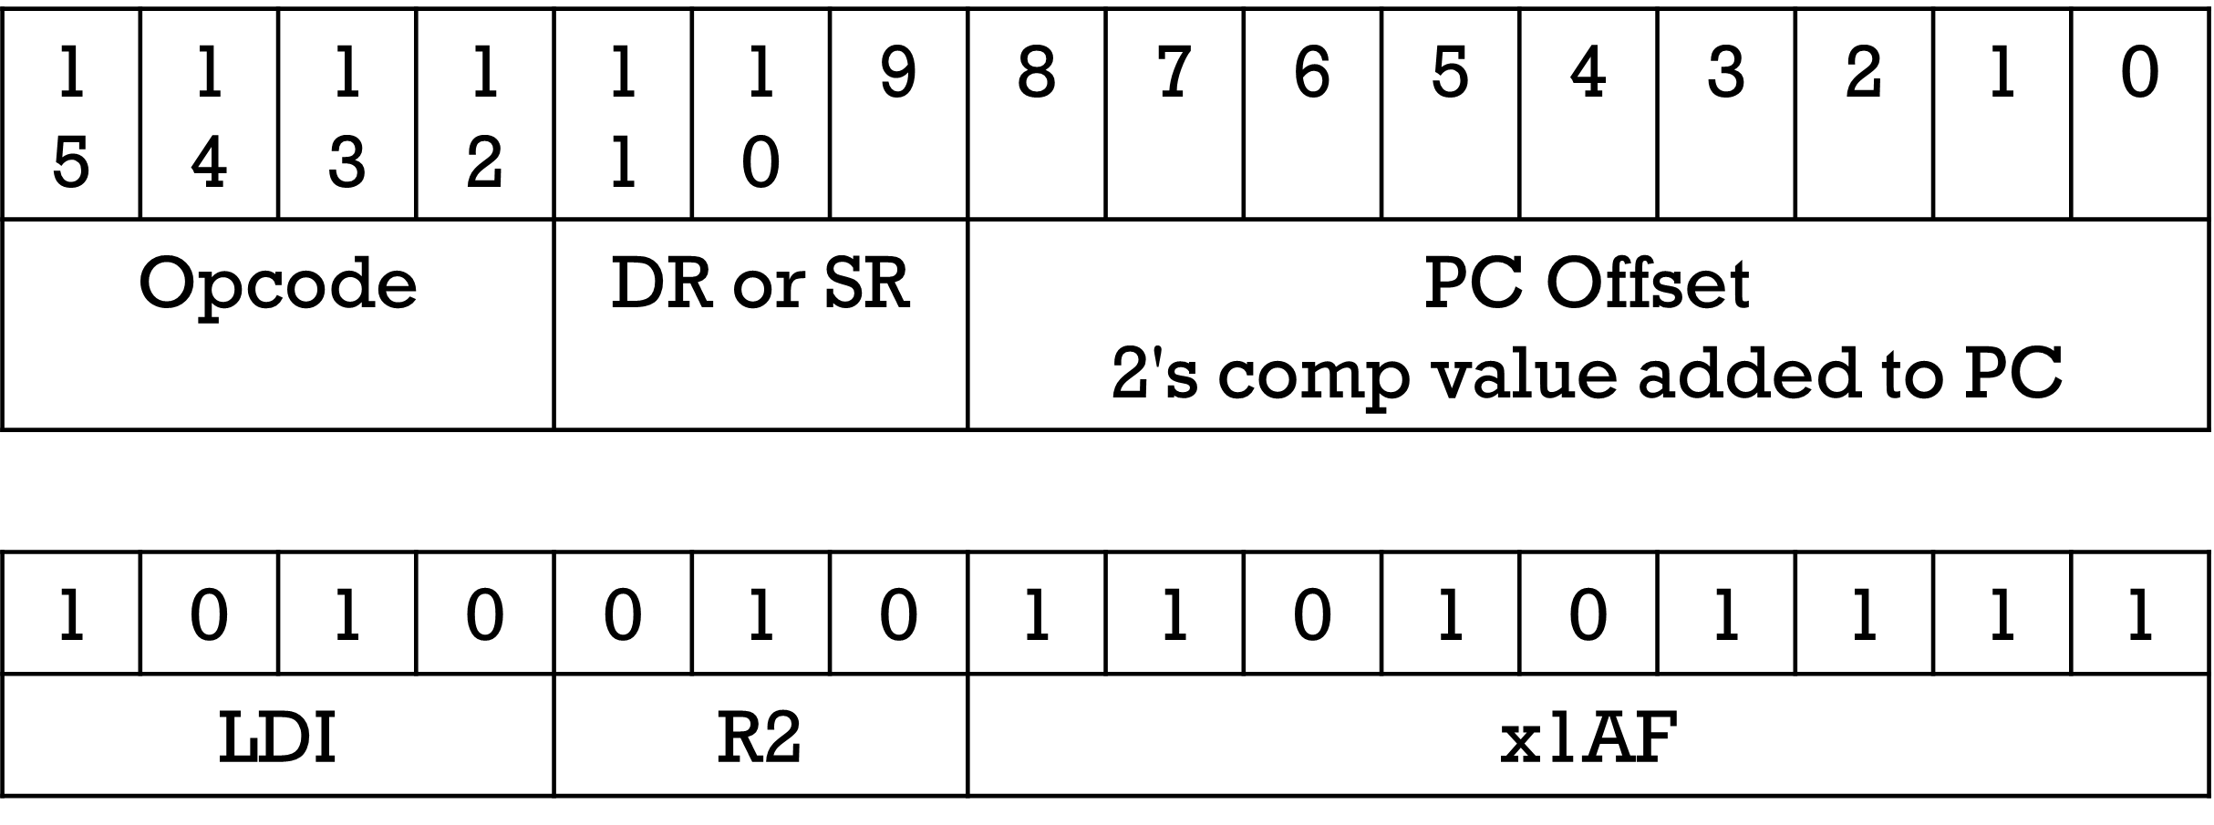
Load Indirect
LDI – Load value from memory and use it as the address of the actual data to move into a register.

Slide 35
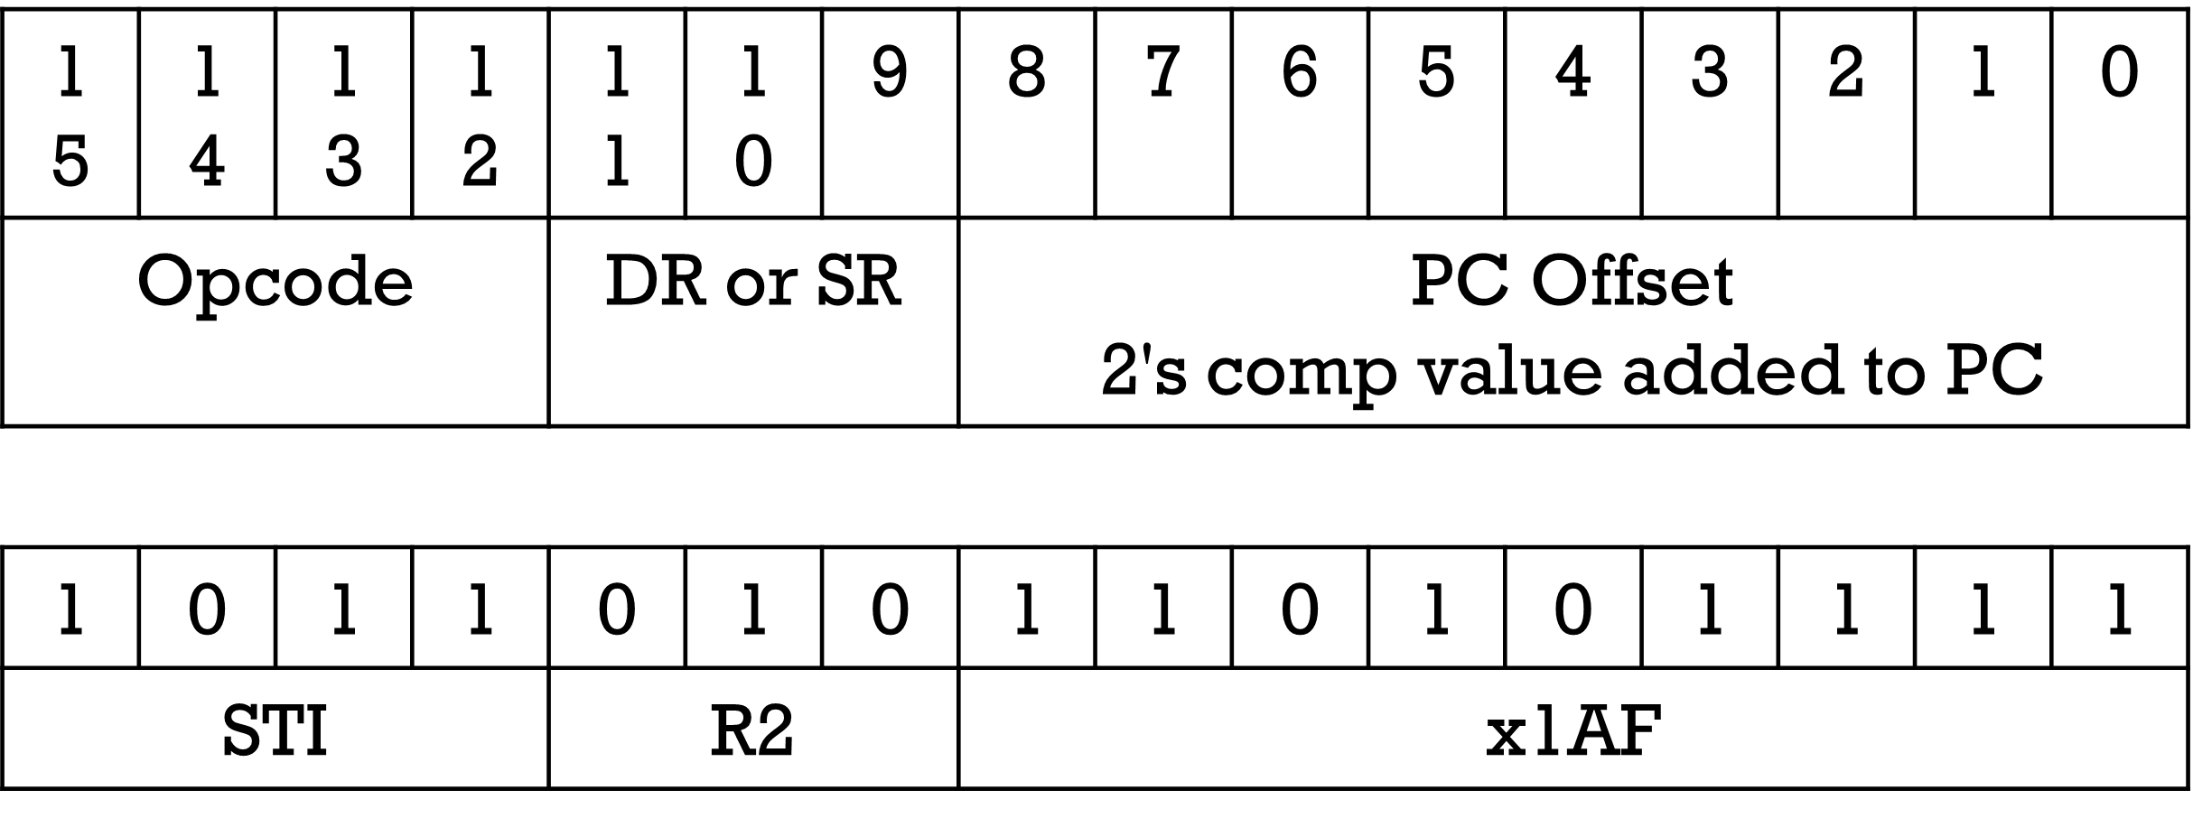
Store Indirect
STI – Save value from register to address specified in memory location.

Slide 36
Example of LDI – Part 1
Address | Value
3000 | A403 | LDI R2, 3 (1010 0100 0000 0011)
3001 | 14A1 | The address is PC + 3 = 3001 + 3 = 3004
3002 | B402 | What is in address 3004?
3003 | FF25
3004 | 300A
3005 | 300C
3006 | 001A
3007 | 00B2
3008 | C133
3009 | 2F25
300A | 0005
300B | 11E2
300C | 0200

Slide 37
Example of LDI – Part 2
Address | Value
3000 | A403 | LDI R2, 3
3001 | 14A1 | The address is PC + 3 = 3001 + 3 = 3004
3002 | B402 | What is in address 3004? 300A
3003 | FF25 | 300A is the Effective Address
3004 | 300A | The operand is stored in 300A
3005 | 300C | What is in address 300A?
3006 | 001A
3007 | 00B2
3008 | C133
3009 | 2F25
300A | 0005
300B | 11E2
300C | 0200

Slide 38
Example of LDI – Part 3
Address | Value
3000 | A403 | LDI R2, 3
3001 | 14A1 | The address is PC + 3 = 3001 + 3 =3004
3002 | B402 | What is in address 3004? 300A
3003 | FF25 | 300A is the effective address.
3004 | 300A | The operand is stored in 300A.
3005 | 300C | What is in 300A? 5
3006 | 001A | R2 will be loaded with 5.
3007 | 00B2
3008 | C133
3009 | 2F25
300A | 0005
300B | 11E2
300C | 0006

Slide 39
Example of adding
Address | Value
3000 | A403
3001 | 14A1 | ADD R2, R2, 1 (0001 010 010 1 0 0001
3002 | B402 | R2 <- R2 + 1
3003 | FF25
3004 | 300A
3005 | 300C
3006 | 001A
3007 | 00B2
3008 | C133
3009 | 2F25
300A | 0005
300B | 11E2
300C | 0200

Slide 40
Example of STi – Part 1
Address | Value
3000 | A403
3001 | 14A1
3002 | B402 | STI R2, 2 (1011 0100 0000 0010)
3003 | FF25 | Store R2 somewhere.
3004 | 300A | What is the address from the instruction?
3005 | 300C
3006 | 001A | What is the effective address?
3007 | 00B2
3008 | C133 | What gets stored where?
3009 | 2F25
300A | 0005
300B | 11E2
300C | 0200

Slide 41
Example of STI – Part 2
Address | Value
3000 | A403
3001 | 14A1
3002 | B402 | STI R2, 2 (1011 0100 0000 0010)
3003 | FF25 | Store R2 somewhere.
3004 | 300A | What is the address from the instruction?
3005 | 300C | 3003 + 2 = 3005
3006 | 001A | What is the effective address?
3007 | 00B2 | 300C
3008 | C133 | What gets stored where?
3009 | 2F25 | MEM[300C] <- 6
300A | 0005
300B | 11E2
300C | 0006

Slide 42
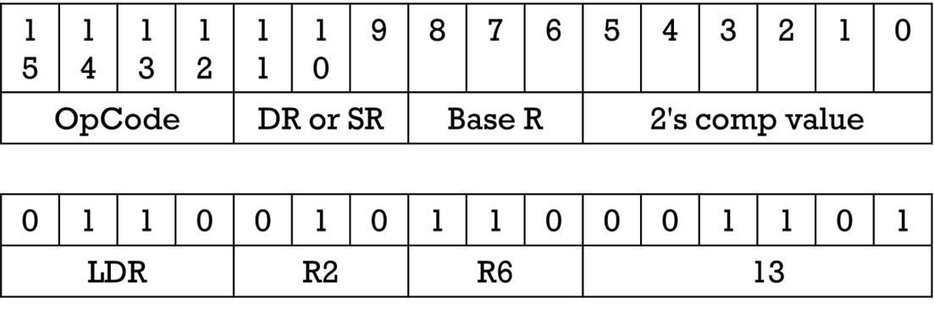
Base Register + Offset
Add an immediate offset to some register.
Easier to calculate for humans.
LDR and STR
Often a register will be dedicated being the memory base.
You need to learn how LDR and STR work.
DON'T USE LDR OR STR IN YOUR PROGRAMS EXCEPT FOR STRING PROCESSING.

Slide 43
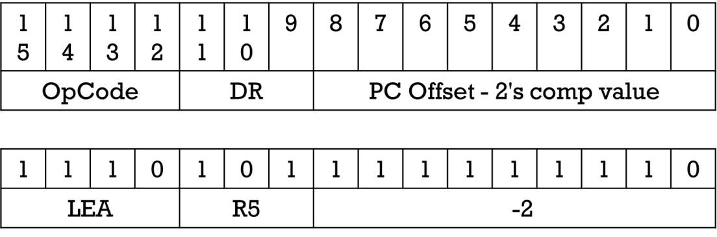
LEA and Immediate Mode
Load Effective Address (LEA) – Puts an address into a register instead of data.
Immediate because it doesn't access memory.
Add 8-bit 2's complement immediate (part of the instruction) data to PC and store in register.

Slide 44
Addressing Modes Summary
Immediate – Data in instruction.
Register – Data is in register.
PC-Relative – Add immediate value to PC to get address of data.
Indirect – PC-Relative gives address of the address of the data and NOT the data directly.
Base + offset – Immediate value is added to an address from a register.

Slide 45
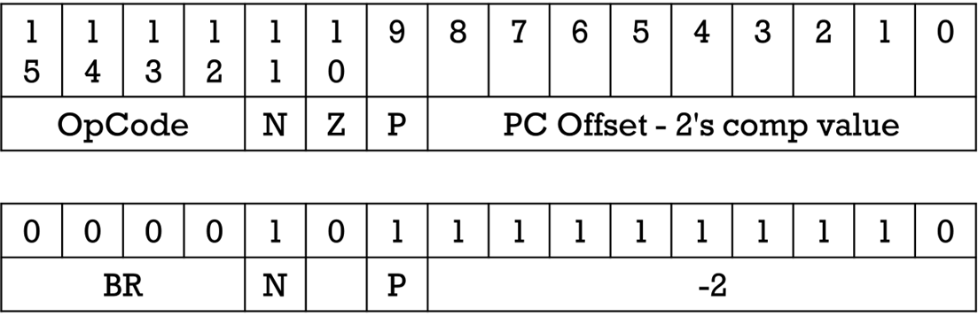
Branching
Branch (BR) – Changes execution order if conditions are met.
Detects Negative, Positive, and Zero
Works in conjunction with one of the following instructions.
ADD, AND, NOT, LD, LDI, LDR, LEA
If one of the above instructions results in a negative, positive, or zero value being written to a register, the appropriate flag (N, P, Z) will be set.

Slide 46
What does this do?
AND R0, R0, #0 (The # lets you know it is immediate)
AND R1, R1, #0
ADD R0, R0, #6
ADD R1, R1, R0
ADD R0, R0, #-1
BRP -3
HALT (What is stored in R1?)
VIDEO ON IF AND THE ABOVE PROGRAM
I AM GOING TO GO THROUGH THIS. TAKE NOTES!!!

Slide 47
Looping and Branching
if (R2 > R1) {
R2 <- R2 + R1
}
We have to translate if(R2 > R1) into a BRNZP.
How? Subtraction.
Replace the operation with the minus sign: R2 - R1
In assembly language, it is easier to think of this as:
"IF THE CONDITION IS FALSE, JUMP OVER THE BLOCK OF CODE"

Slide 48
Using Subtraction To Set Flags
if(R2 > R1) {R2 <- R2 + R1}
Subtract R1 from R2. (R2 – R1)
What is the result if R2 is smaller? N, Z, or P?
What is the result if R2 = R1? N, Z, or P
What is the result if R2 is greater? N, Z, or P?
If R2 < R1 (N) or R2 = R1 (Z) skip the add code.
NOT R3, R1 (Invert R1 and put in R3)
ADD R3, R3, #1 (Add 1 to R3, R3 is now –R1)
ADD R3, R2, R3 (Add R3 to R2. Same as R2 – R1)
BR_ _ _ ____ (Jump over add if R2 <= R1)
ADD R2, R2, R1

Slide 49
Results
if(R2 > R1) {R2 <- R2 + R1}
Subtract second from first, R1 from R2. (R2 – R1)
What is the result if R2 is smaller (R2<R1) ? N, Z, or P?
What is the result if they are same (R2 == R1)? N, Z, or P
What is the result if R2 is greater (R2>R1) ? N, Z, or P?
If R2 < R1 (N) or R2 = R1 (Z)skip the add.
NOT R3, R1 (Invert R12 and put in R3)
ADD R3, R3, #1 (Add 1 to R3, R3 is now –R1)
ADD R3, R2, R3 (Add R3 to R2. Same as R2 – R1)
BRNZ 1 (Jump over add if R2 < R1 or R2 == R1)
ADD R2, R2, R1

Slide 50
If (R0 > R1)
This is how the flags will be set for R0 – R1
if R0 is smaller (R0<R1), the N flag will be set.
if they are equal (R0==R1), the Z flag will be set
if R0 is bigger (R0>R1), the P flag will be set.
if (R0 > R1) {
block1
}
We want to run block1 if R0 > R1, which means we want to BRANCH to the code AFTER block1 when R0 <= R1
Use BRNZ (X when R0 is lesser and Z when the are the same)

Slide 51
If (R0 < R1)
This is how the flags will be set for R0 – R1
if R0 is smaller (R0<R1), the N flag will be set.
if they are equal (R0==R1), the Z flag will be set
if R0 is bigger (R0>R1), the P flag will be set.
if (R0 < R1) {
block1
}
We want to run block1 if R0 < R1, which means we want to BRANCH to the code AFTER block1 when R0 >= R1
Use BRZP (P when R0 is greater and Z when they are the same)

Slide 52
If (R0 == R1)
This is how the flags will be set for R1 – R0
if R0 is smaller (R0<R1), the N flag will be set.
if they are equal (R0==R1), the Z flag will be set
if R0 is bigger (R0>R1), the P flag will be set.
if (R0 == R1) {
block1
}
We want to run block1 if R0 == R1, which means we want to BRANCH to the code AFTER block1 when R0 >R1 or R0 < R1
Use BRNP (P if R0 is greater and N if R0 is lesser)

Slide 53
If (R0 != R1)
This is how the flags will be set for R0 – R1
if R0 is smaller (R0<R1), the N flag will be set.
if they are equal (R0==R1), the Z flag will be set
if R0 is bigger (R0>R1), the P flag will be set.
if (R0 != R1) {
block1
}
We want to run block1 if R0 != R1, which means we want to BRANCH to the code AFTER block1 when R0 == R1
Use BRZ (Z means they were the same)

Slide 54
If (R0 >= R1)
This is how the flags will be set for R0 – R1
if R0 is smaller (R0<R1), the N flag will be set.
if they are equal (R0==R1), the Z flag will be set
if R0 is bigger (R0>R1), the P flag will be set.
if (R0 >= R1) {
block1
}
We want to run block1 if R0 >= R1, which means we want to BRANCH to the code AFTER block1 when R0 < R1
Use BRN (N means R0 was smaller)

Slide 55
If (R0 <= R1)
This is how the flags will be set for R0 – R1
if R0 is smaller (R0<R1), the N flag will be set.
if they are equal (R0==R1), the Z flag will be set
if R0 is bigger (R0>R1), the P flag will be set.
if (R0 <= R1) {
block1
}
We want to run block1 if R0 <= R1, which means we want to BRANCH to the code AFTER block1 when R0 > R1
Use BRP (P means R0 was bigger)

Slide 56
If - Else
IF CONDITION FALSE BRANCH TO BLOCK 2
BLOCK1
UNCONDITIONAL BRANCH (BRNZP or BR) OVER BLOCK2 SINCE BLOCK 1 WAS RUN
BLOCK2
if (R1 > R2)
{
R1 = R1 – R2 //Block 1
}
else
{
R1 = R2 – R1 //Block 2
}

Slide 57
If – Else 1
IF CONDITION FALSE BRANCH TO BLOCK 2
BLOCK1
UNCONDITIONAL BRANCH OVER BLOCK2 SINCE BLOCK 1 WAS RUN
BLOCK2
if (R1 > R2)
{
R1 = R1 – R2 //Block 1
}
else
{
R1 = R2 – R1 //Block 2
}
BLOCK 1 (R1 <- R1 – R2)
NOT R2, R2 ADD R2, R2, #1 ADD R1, R2, R1
BLOCK 2(R1 <- R2 – R1)
NOT R1, R1 ADD R1, R1, #1 ADD R1, R2, R1

Slide 58
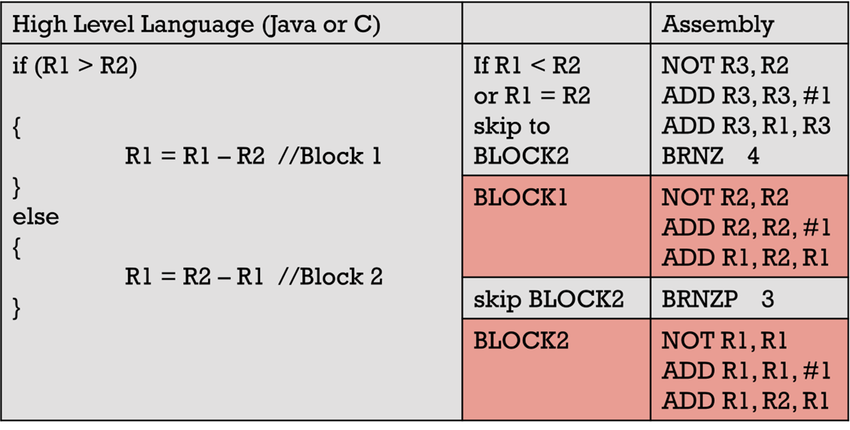
If – Else 2
IF CONDITION FALSE BRANCH TO BLOCK 2
BLOCK1
UNCONDITIONAL BRANCH OVER BLOCK2 SINCE BLOCK 1 WAS RUN
BLOCK2

Slide 59
Getting A character and printing A character
The instruction to get a character is a TRAP instruction
GETC
F020
GETC will ALWAYS put the ASCII code of the keystroke in R0.
The instruction to PRINT a character is a TRAP instruction
OUT
F021
With OUT you must always have the ASCII code of the character in R0.
This program will get and print a character
3000
F020
F021
F025

Slide 60
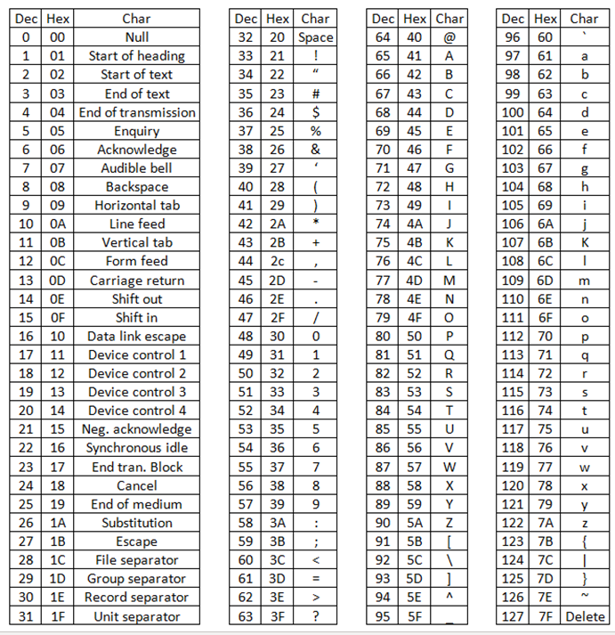
ascii

Slide 61
Constants and Printing
Suppose you wanted to print the value in R0 but only if it was the character 'A'.
We would want to subtract the ASCII code for 'A' from R0. If the result of the subtraction is zero, we know the character is an 'A' and we can print it.
But how do we store the ASCII code for 'A'

Slide 62
Storing Constants
We can simply store the constant as part of our program.
We must be careful NOT to put the constant where it might get executed.
A safe place is AFTER the HALT instruction.
F025 ;The program stops here
0041 ;The ASCII code for A

Slide 63
Variable data must be kept out of the instruction area
We can simply store the constant as part of our program.
We must be careful NOT to put the constant where it might get executed.
This is a problem because the LC3 will attempt to execute the 0041 thinking it is a branch.
0041 ;WRONG NOT HERE. PUT DATA AFTER HALT.
F025 ;The program stops here

Slide 64
Store negative values to save execution steps
In this example we need to subtract a constant from R0.
R0 - 0x0041 where 0x0041 is the ASCII code for 'A' .
How to load constants for comparisons
We can load 0x0041 from memory, then invert the bits, then add 1 to make it negative (3 instructions executed).
OR
We can simply load the negative version (1 instruction executed).
WE ALWAYS WANT TO LOAD THE NEGATIVE VERSION WHERE POSSIBLE.
F025 ; HALT
FFBF ; -65

Slide 65
Getting a character from the keyboard
GETC is a trap
Use F020 for the hex
Always puts the ASCII code of the key typed into R0.
You must save any data from R0 (i.e., move it to another register) before using GETC if it is important.
GETC will stop program execution and wait for you to type something in the console.
GETC goes into a loop until a character is typed. It then exits with the ASCII code of that character in R0.

Slide 66
Printing a single character
The LC3 does not have an instruction for printing.
Hardware exists which allows printing but it takes many instructions to use that hardware.
Printing requires a subroutine.
A TRAP is an instruction in the LC3 that allows calling of an operating system level subroutine.
The "print a character" subroutine/trap is called OUT.
It has a trap vector of 0x21 so you will sometimes see it shown as TRAP 0x21.
The hex for OUT will always be F021.
It will print the ASCII code stored in R0.
The value MUST be stored in R0. No other register will work.
OUT R1 ;DOES NOT WORK. WONT COMPILE.
OUT ; Will print the character whose ASCII is in R0.

Slide 67
HEX Print character in R0 if it is 'A'
3000
2204 LD R1, 4 ; Load ASCII 'A' into R1
1201 ADD R1, R0, R1 ; R1 <- R0 – 'A'
0A01 BRNP 1 ; Branch if not zero
F021 Print character; Trap for print (F021)
F025 HALT ; Trap for halt (F025)
FFBF ; ASCII 'A'

Slide 68
Jumping Around
JSR – Jump to Subroutine or Jump Save Return.
Return address (PC) saved in R7.
11-Bit PC relative addressing.
JSRR – Jump to Subroutine
Return address (PC) saved in R7.
Base register addressing.
JMP – Jump without saving return.
Base register addressing.
RET – Special form of JMP
Base register is always register R7.
BRNZP or BR – Unconditional branch. BR and BRNZP both will always branch.
9-Bit PC relative addressing.

Slide 69
TRAP
GETC - Get a character from keyboard (F020).
No prompt is printed.
Execution stops and waits for a key to be pressed.
Store the ASCII code in R0.
OUT - Send a single character to output (F021).
ASCII character must be stored in R0.
PUTS - Print null terminated string to the output (F022).
ADDRESS of string must be stored in R0.
IN - Get character from keyboard (F023).
Print prompt "Input a character>"
Stop and wait for a key to be pressed
Store the ASCII code in R0.
Prints the character to the display.
PUTSP – Print null terminated string to the output (F024)
Same as PUTS but assumes two characters per word.
Address of string must be stored in R0.
HALT – Stop execution of the processor (F025).

Slide 70
Printing Strings
HEX File | Assembly
3000 |  | ;Where the program starts
E002 | LEA R0, 2 | ;R0 <- Address of string
F022 | PUTS | ;DISPLAY <- String starting at R0
F025 | HALT | ;Stop the program
0048 | H | ;The string one character at a time
0065 | e
006C | l
006C | l
006F | o
0000 | \0 | ;NULL termination
Note the use of LEA and PUTS to print strings.
Use LD and OUT to print a single character.
Use LEA and PUTS is required to print strings.
The string MUST be null terminated!!

Slide 71
PRINTING STRINGS VS Printing A Single character
Printing strings
Use LEA to load R0 with the ADDRESS of the first character
Use PUTS to print the string
Printing a character
Use LD to load R0 with the ASCII CODE of the character.
Use OUT to print the character.

Slide 72
Addressing Modes Summary (again)
Immediate – Data is part of the instruction.
Register – Data is in a register.
PC-Relative – Add immediate value to PC to get address of data.
Indirect – PC-Relative calculation gives address of the address of the data and NOT the data directly.
Base + offset – Immediate value is added to an address from a register.

Slide 73
Opcode Summary (again)
Add - ADD value in a register to a value in a register. Store result in a register.
Add - ADD value in a register to a number. Store result in a register.
And - Bitwise AND value in a register to a value in a register. Store result in a register.
And - Bitwise AND value in a register to a number. Store result in a register.
Not – Invert all the bits in a register and store the result in a register.
BR, BRNZP – Conditional branch. Like if statement.
LD, LDR, LDI* – Load register with a value from memory
ST, STR, STI* – Store register value somewhere in memory.
LEA – Load an address into a register and not the data.
JMP* – Jump execution to some other place in memory.
JSR, JSRR* – Jump to a subroutine similar to a function or method.
RET – Return from the subroutine
RTI* – Return from interrupt, restores process information.
TRAP – System call. Like an operating system. Handles input and output.
Don't use instructions marked with * in programs in this class.

